Slide 1
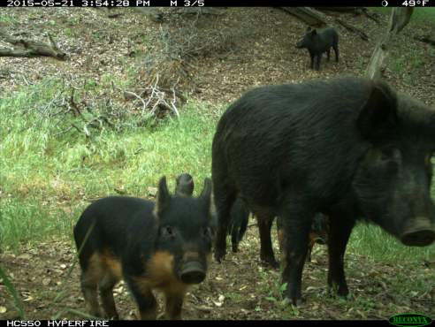
North-American animal classification
DSPRO01 – Autumn 2024
Nadine Flück, Sevan Sherbetjian, Michelle Suter
Notes:
Welcome to our presentation. Our project is north American animal classification.

Slide 2
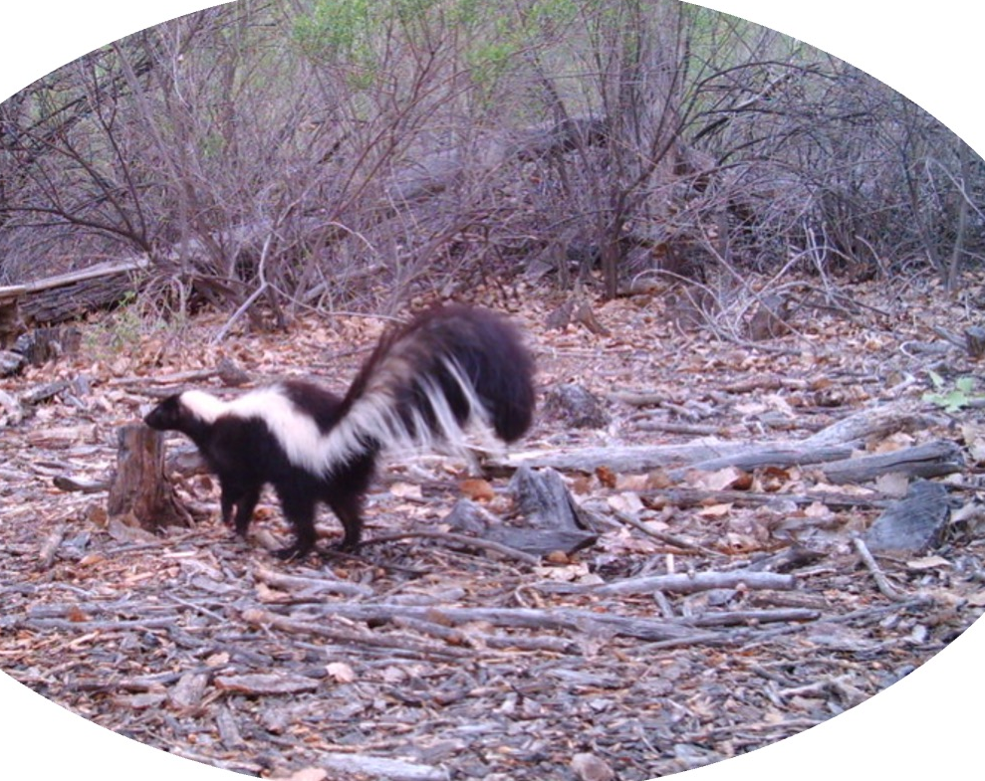
Introduction
Use Case
Project state
Dataset
Models
Next steps
DSPRO Group3 | Autumn 2024
Notes:
First we’re going to tell you a bit more about our usecase and then talk about our project state – the data we used, models we tested and what our next steps will be.

Slide 3
Risks for wild animals
Habitat loss and human activities (agriculture, roads, etc.)
Climate change
Extinction
DSPRO Group3 | Autumn 2024
Notes:
Wild animals face significant risks today, primarily due to human activities.
Habitat loss is one of the biggest threats. As we expand agriculture, build roads, and develop new areas, natural habitats shrink, leaving animals with fewer places to live, hunt, and reproduce.
Climate change makes this problem worse. It changes the environment, like food sources and affects migration patterns. Some species struggle to adapt to these rapid changes, which brings us to the third major risk—extinction.
With these mounting pressures, it’s clear that conservation efforts are critical.
To protect wildlife and nature’s diversity, we need to take action.

Slide 4
How to protect wild animals?
DSPRO Group3 | Autumn 2024
Notes:
But how can we protect wild animals?

Slide 5
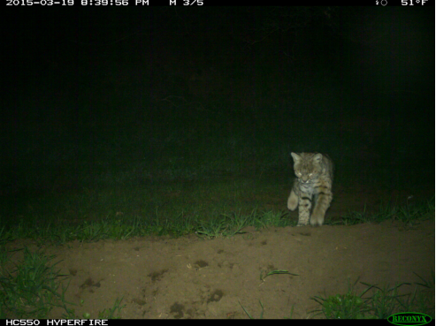
Problems
Wild animals are difficult to observe
Observation is time consuming
We don’t know all the species located in an area
DSPRO Group3 | Autumn 2024
Notes:
Monitoring wild animals is very important for conservation,
but there are several challenges that make it hard to gather the data needed:
Wild animals are hard to observe: Many animals avoid people, so it’s difficult to find and track them. Some animals are also active at night or live in areas that are hard to reach. This means that
Observation takes a lot of time: Researchers use camera traps to capture photos or videos of animals, but it takes a lot of time to go through all the footage. Tracking animals by hand in the field also takes a lot of time and effort. In addition we have
Limited knowledge about where animals are: In large or remote areas, we often don’t know which animals live there or how they move around. This makes it hard to protect them properly.

Slide 6
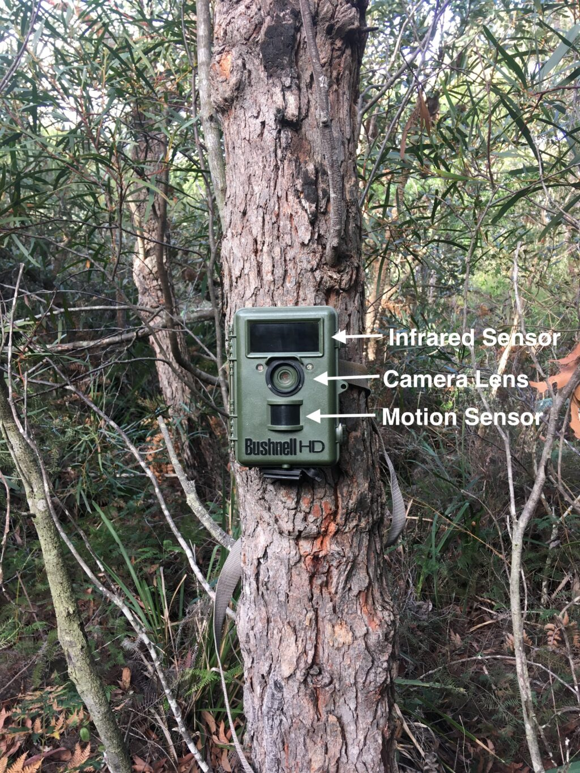
Our Solution
Camera traps: non invasive, active in all conditions (night, etc.)
Machine learning for animals classification
Source: https://malleedesign.com.au/camera-trap-basics-for-bird-spotters/
DSPRO Group3 | Autumn 2024
Notes:
To solve these problems, we use camera traps and machine learning:
Camera traps are a non-invasive way to monitor wildlife. They operate around the clock and under all conditions, capturing images day and night without disturbing animals.
We’re using machine learning for animal classification, which allows us to automatically identify and categorize species in the images collected from these cameras.
((Our machine learning models can process thousands of images quickly and accurately, saving researchers the time and effort of manual classification))
((infrared sensor: looks for combination of movement and change in ambient temperature.))

Slide 7
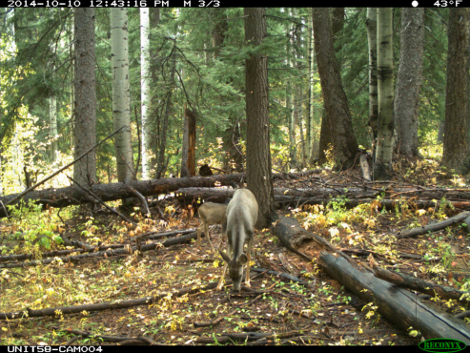
How our solution contributes to wildlife protection
Large datasets can be analyzed faster and more accurately
Early Detection
impacts of habitat loss can be analyzed
Adapting to Climate Change
Long-Term Data Analysis
Targeted Conservation
Preventing Extinction
Strengthened Protection
DSPRO Group3 | Autumn 2024
Notes:
Large datasets can be analyzed faster and more precisely
And therefore endangered species or changes in biodiversity can be identified quickly, allowing for timely interventions.
By analyzing the distribution and frequency of species, researchers can understand the impacts of habitat loss on different animals.
Trends can be identified over time, such as animals relocating to new areas or population declines due to environmental changes.
Insights from the data can help conservation organizations adjust their strategies and expand protections for vulnerable species.
((Researchers can prioritize areas or species most affected by climate change))

Slide 8
Old Dataset
African Jungle: data transformation
Data quality and data cleaning
Too many pictures with no animal visible for the human eye
No way to automatize the cleaning
Unbalanced
DSPRO Group3 | Autumn 2024
Notes:
We began with an African jungle dataset from DrivenData that initially seemed promising. But we quickly encountered some challenges in data quality that impacted our ability to train a reliable model effectively. A significant issue was that many images contained no visible animals, at least to the human eye. So some photos were labled as containing specific animals, but we couldn’t visually identify any animals in them. This raised questions about label accuracy, so we contacted the data publisher for clarification, and they assured us that animals were present.
This feedback helped us to understand that while there might be an animal in the image, it wasn’t visible enough for consistent human identification - which means that it will also be challenging for a machine learning model to identify them. And we will struggle to verify the results as well.
Given the high number of those images, we couldn’t automate the data cleaning process effectively. Because filtering out irrelevant images required manual review, which was time-consuming.
Overall, the challenges with this dataset taught us the importance of good and clear data.

Slide 9
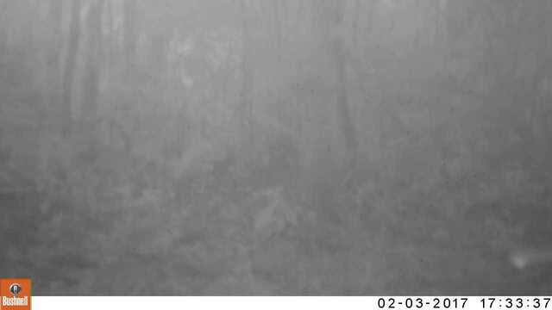
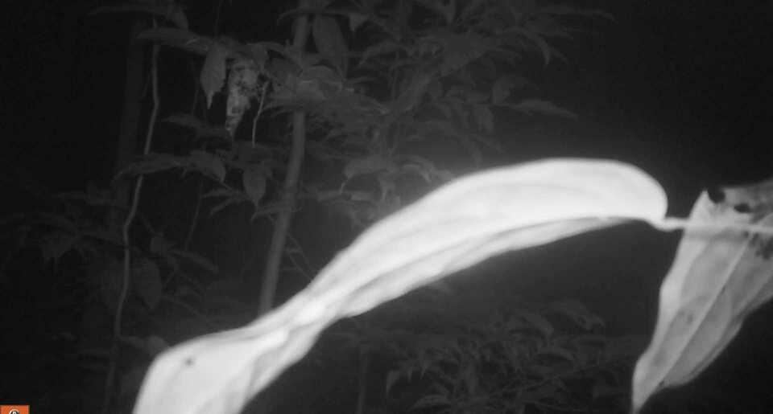
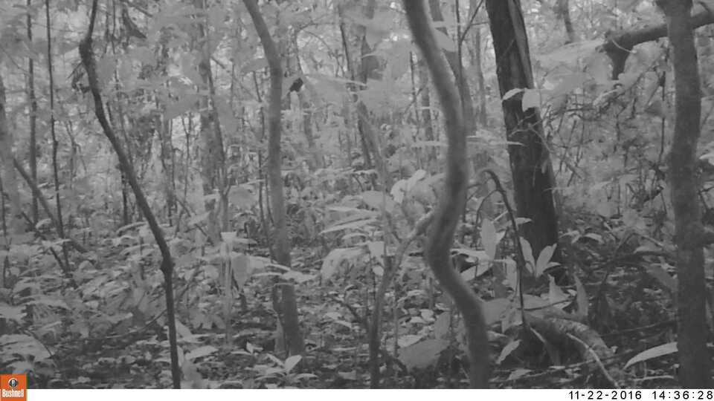
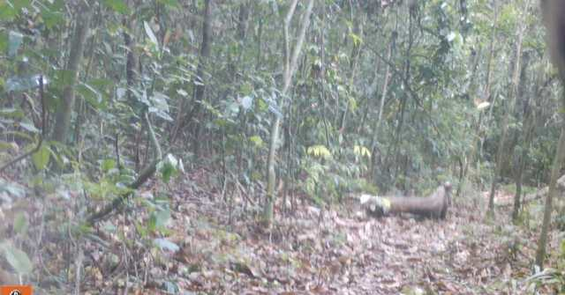
Label: Antelope
Label: Leopard
Label: Monkey
Label: Leopard
DSPRO Group3 | Autumn 2024
Notes:
Here are some of the pictures I talked about.

Slide 10
New Dataset: North American wild animals
Selected 12 categories
3’000 pictures / category
Balanced dataset
Source: Labeled Information Library of Alexandria: Biology and Conservation
DSPRO Group3 | Autumn 2024
Notes:
To address the issues we had with our old dataset, we chose a North American wildlife dataset from LILA. This is a really large dataset. So we decided to pick 12 categories and start with each 3’000 Images. That’s why our dataset is balanced. If needed – we could add more pictures.

Slide 11
Labels
American black bear | Mule deer
Bobcat | Red deer
California ground squirrel | Deer
Coyote | Striped skunk
Elk | Wild boar
Gray fox | Empty
DSPRO Group3 | Autumn 2024
Notes:
Here you can see our labels.

Slide 12
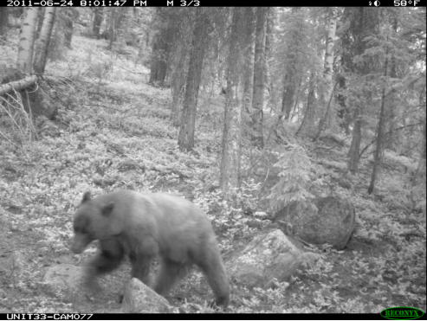
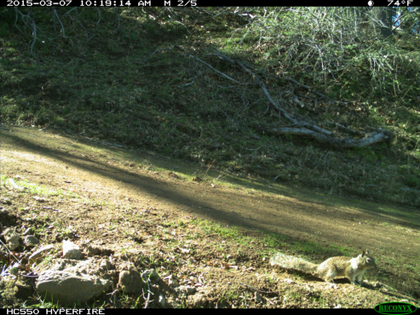
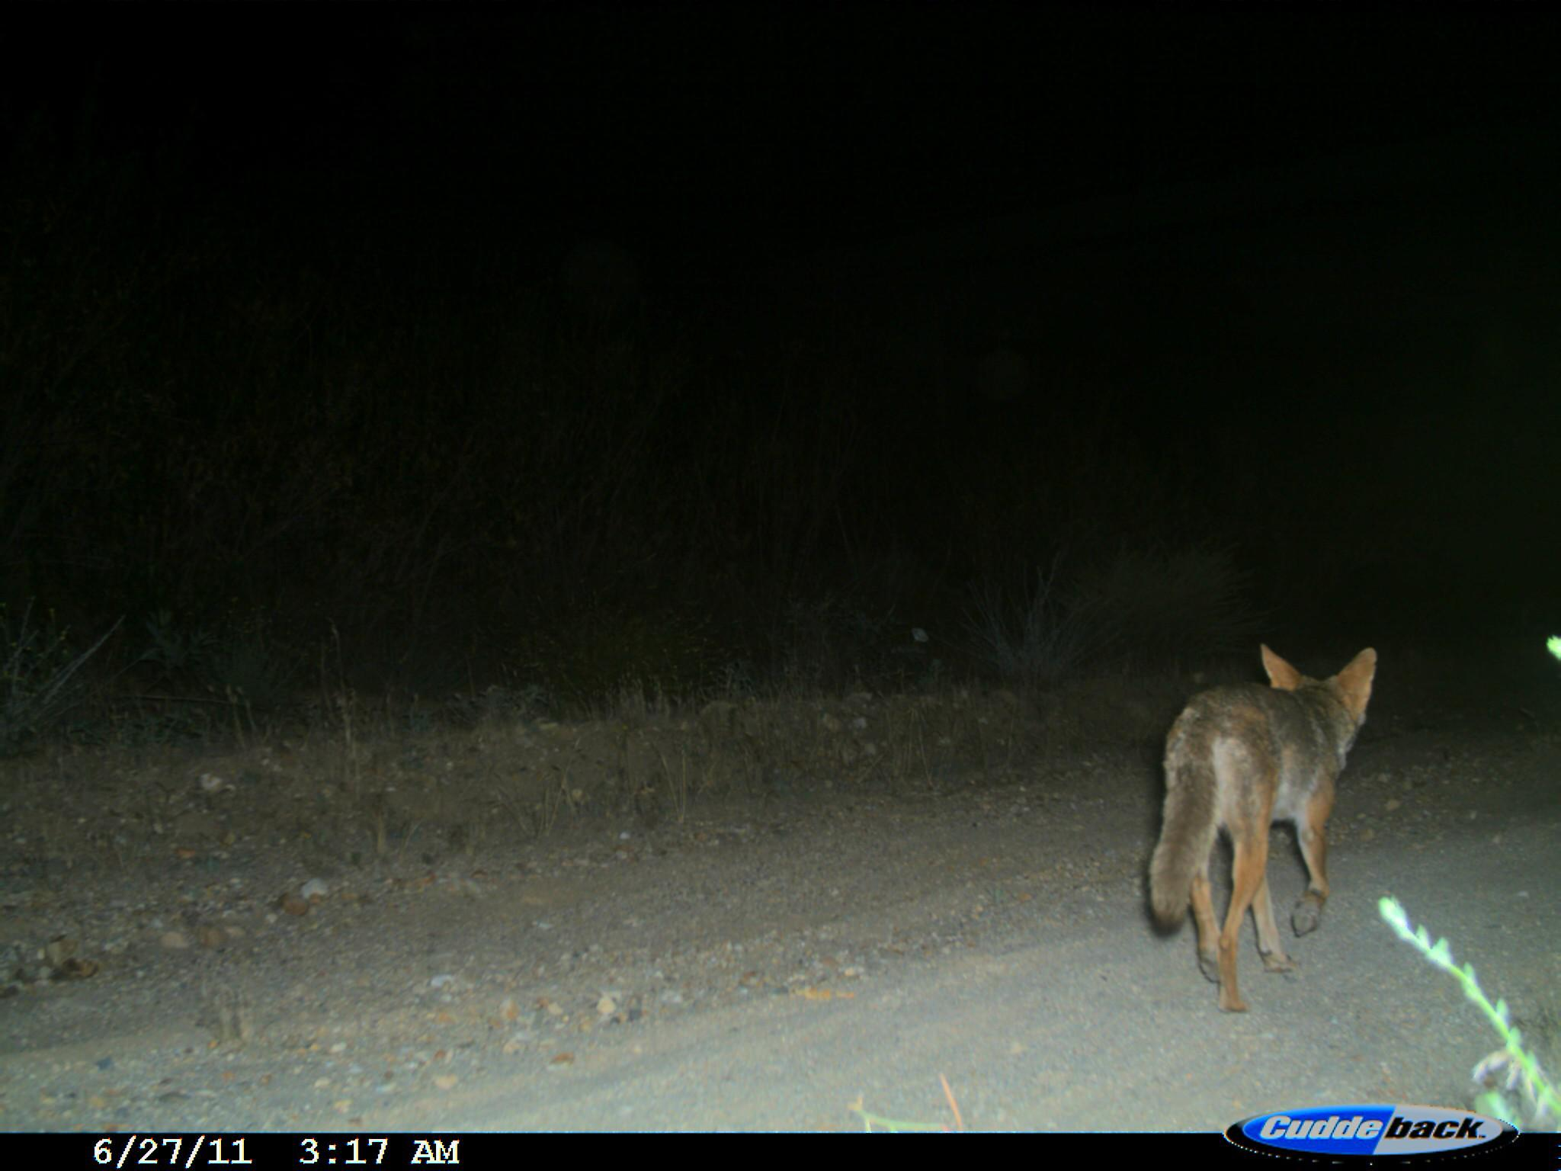
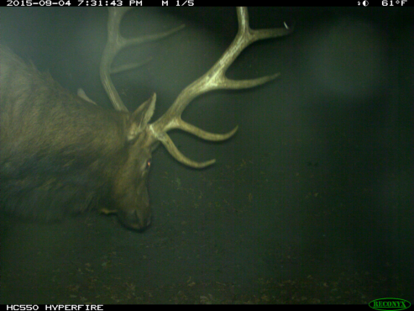
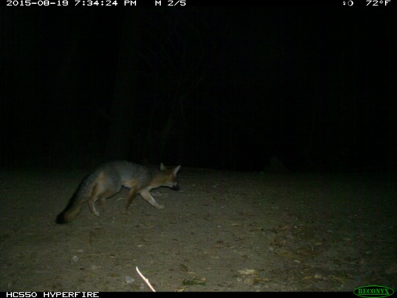
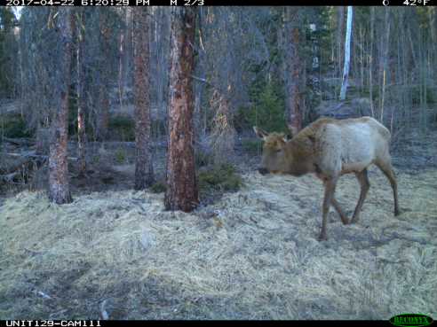
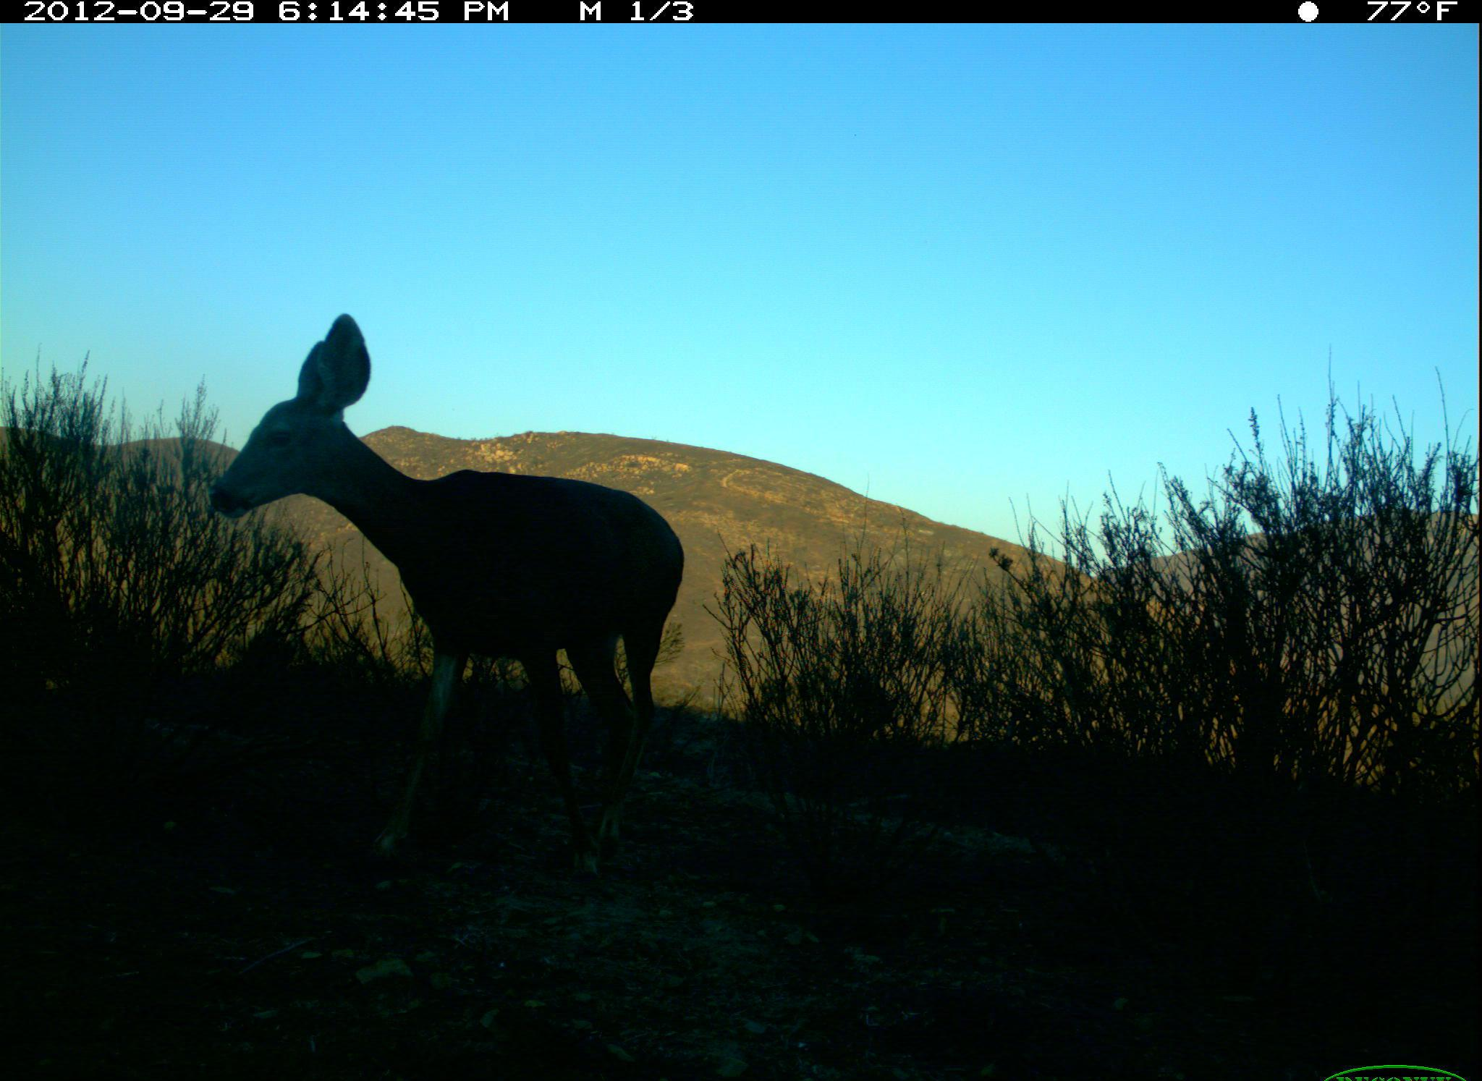
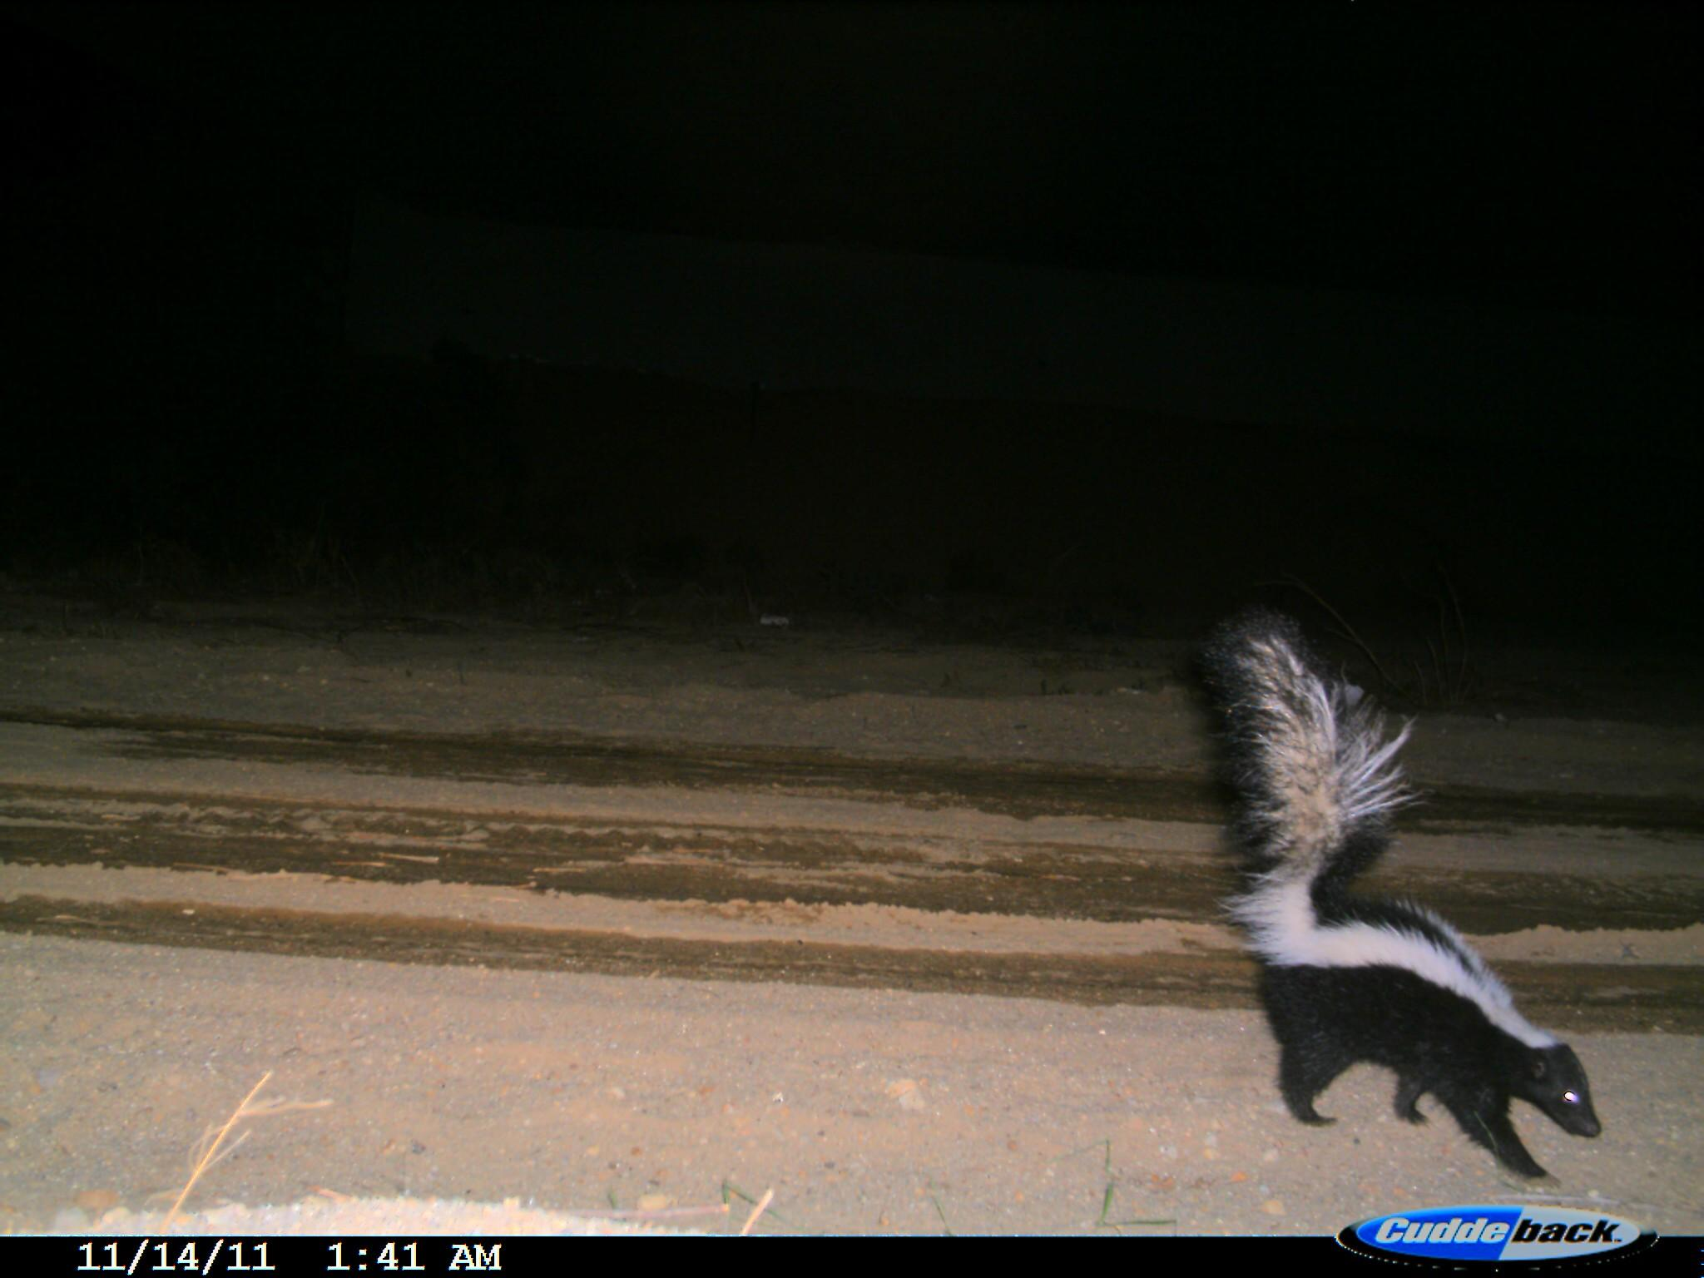
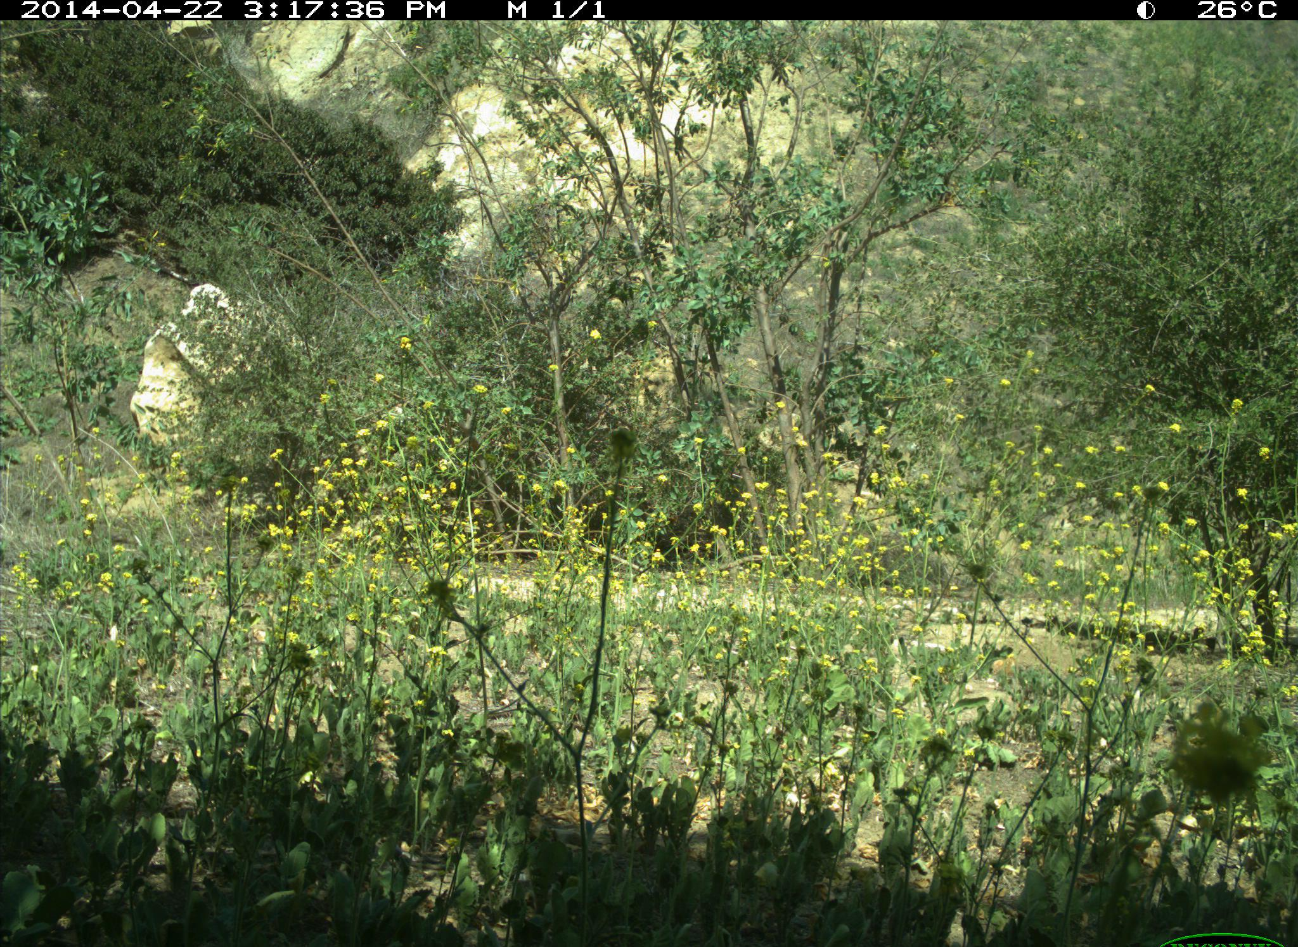
American black bear
Bobcat
California ground squirrel
Coyote
Elk
Gray fox
Mule deer
Red deer
Deer
Skunk
Wild boar
Empty
DSPRO Group3 | Autumn 2024
Notes:
And here are some images from our new dataset.
Following our experience with the previous dataset, we avoided very small animals like mice. These are difficult to spot on the picture and tend to hide behind leaves or other elements. Most of the selected animals are rather big and we included squirrels and skunk. We will observe if this make a difference in our results. We also have very similar breeds of deers as a challenge and will see if the model can tell them apart well.

Slide 13
Models
Exploration of different models
EfficientNet
2019 – Google
Efficient
Scalable
89% accuracy
On our dataset
Resnet
2015 – Microsoft
Feature extraction
Transfer learning
94% accuracy
On our dataset
Vision Transformers
2020 – Google
Efficient
Scalable to big datasets
91% accuracy
On our dataset
DSPRO Group3 | Autumn 2024
Notes:
A Transformer is a type of neural network used mainly for tasks like language processing. It uses a mechanism called self-attention to understand how words or parts of data relate to each other, no matter how far apart they are. This allows Transformers to process data faster and more efficiently than older models like RNNs.
A Vision Transformer (ViT) is a neural network model designed for image processing, utilizing the Transformer architecture, which was originally developed for natural language processing (NLP).
The ViT splits an image into smaller patches (e.g., 16x16 pixels) and treats these patches like tokens in a sequence. These patches are then embedded into vectors and passed through Transformer layers to learn relationships and extract features. The model is particularly effective at capturing long-range dependencies in images, but generally requires larger datasets and more computational resources than CNNs.

Slide 14
Models
Exploration of different models
EfficientNet (89.91 % accuracy)
Resnet (94.92% accuracy)
Vision Transformers (91%)
Without transfer learning: baseline
DSPRO Group3 | Autumn 2024
Notes:
A Transformer is a type of neural network used mainly for tasks like language processing. It uses a mechanism called self-attention to understand how words or parts of data relate to each other, no matter how far apart they are. This allows Transformers to process data faster and more efficiently than older models like RNNs.
A Vision Transformer (ViT) is a neural network model designed for image processing, utilizing the Transformer architecture, which was originally developed for natural language processing (NLP).
The ViT splits an image into smaller patches (e.g., 16x16 pixels) and treats these patches like tokens in a sequence. These patches are then embedded into vectors and passed through Transformer layers to learn relationships and extract features. The model is particularly effective at capturing long-range dependencies in images, but generally requires larger datasets and more computational resources than CNNs.

Slide 15
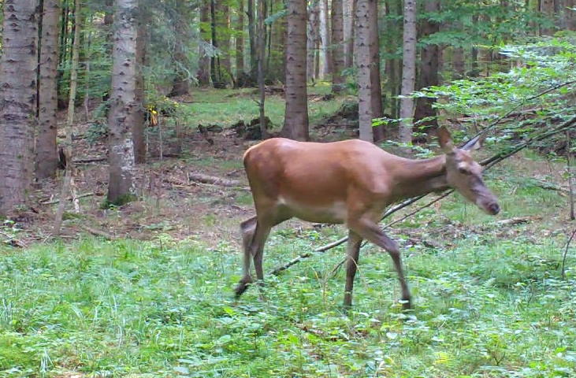
Next steps
Verify our baseline
Transfer learning with Resnet
Optimization:
Goal: beat baseline
DSPRO Group3 | Autumn 2024
Notes:
Our next steps involve optimizing our chosen model through transfer learning, enhancing accuracy. The ultimate goal is to create a model that surpasses our current baseline and effectively classifies North American animals for conservation efforts.

Slide 16
Thanks for your attention
DSPRO Group3 | Autumn 2024

Slide 17
Sources
https://aldf.org/focus_area/wildlife/
https://malleedesign.com.au/camera-trap-basics-for-bird-spotters/
DSPRO Group3 | Autumn 2024

